Slide 1


Defending our climate from change
18 June – adults
13h30 Session
Natasja warnick
Stakeholder Engagement Officer

Slide 2
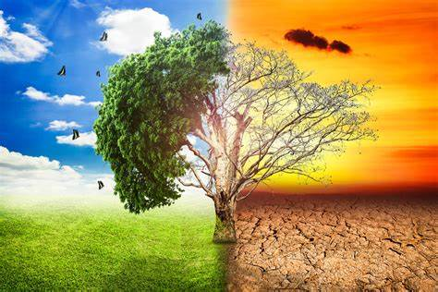
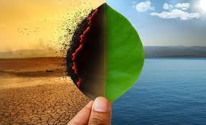
What is Climate Change?
Long term change in weather patterns
Can be natural or due to human activity
Natural ?
Human activity?

Slide 3
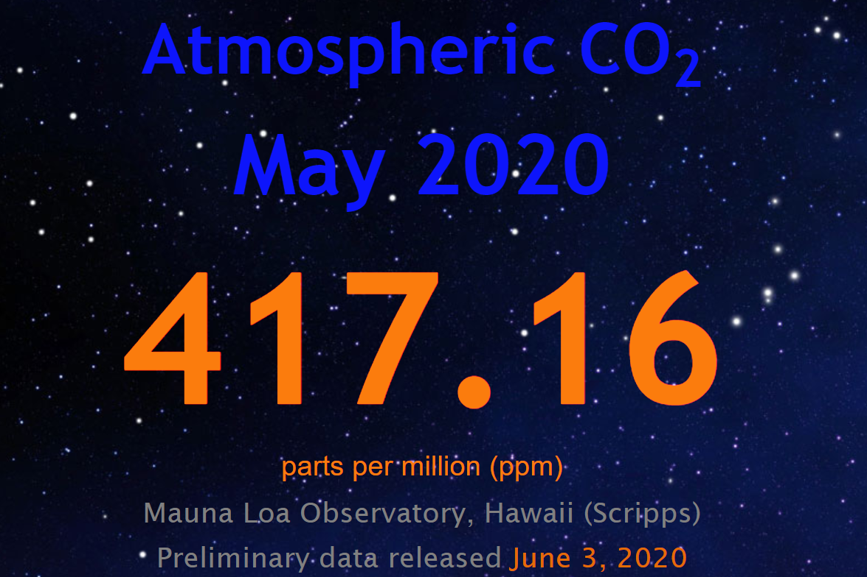
350 parts per million.
This is the identified as the safe upper limit of carbon dioxide parts per million to avoid a climate tipping point.

Slide 4
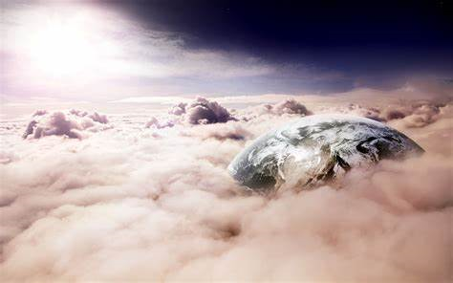
The Green House Effect

Slide 5
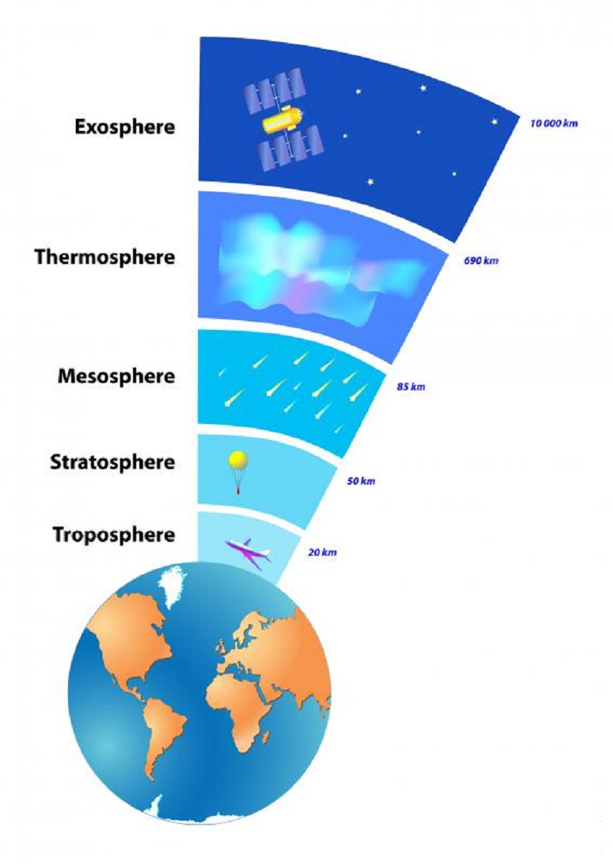
The atmosphere
The atmosphere has many different layers
Radio waves are reflected back to earth and it absorbs dangerous X-Rays from the sun as well as Ultra Violet light from here (80km – 350+ km)
The ozone is found here (it absorbs Ultra Violet light from the sun (10 – 50 km)
Small rocks/ shooting stars burn up here (50 km – 80km)
Animals and plants live here (sea level to 10km)

Slide 6
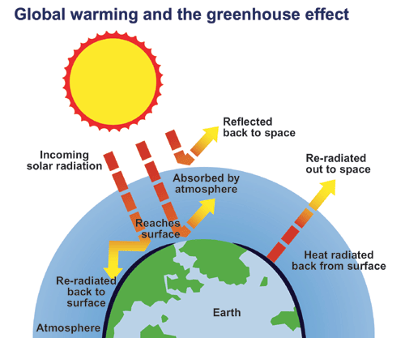
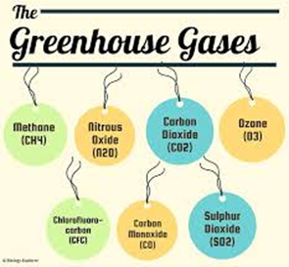
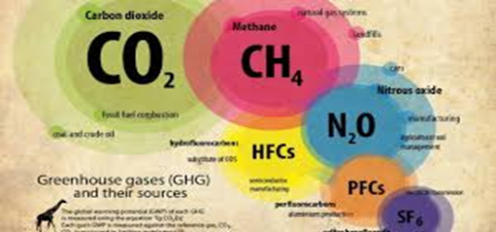
The greenhouse effect
The greenhouse effect is a natural phenomenon
Gases trap the UV radiation that then warms the air closest to the surface of the earth
The greenhouse gases are carbon dioxide, water vapor, methane
Scientists are more than 95% certain that nearly all of global warming is caused by increasing concentrations of greenhouse gases and other human emissions

Slide 7
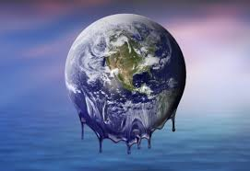
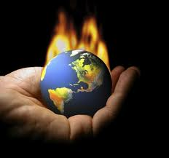
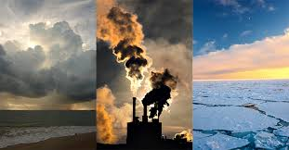
Global Warming and Climate Change

Slide 8
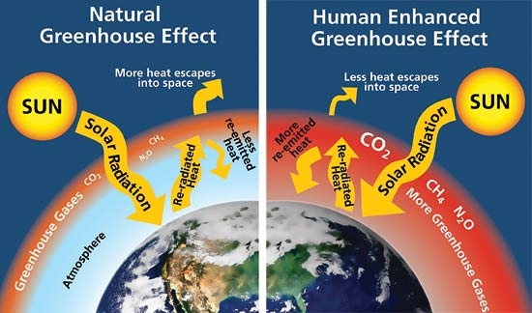
What is global warming?
An increase in greenhouse gases leads to global warming
Global warming is the increase of the average temperature of the atmosphere
Global warming is a term used for the observed century-scale rise in the average temperature of the Earth's climate systems.

Slide 9
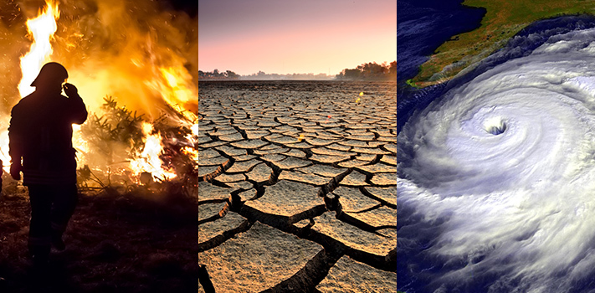
What does global warming mean for us?
Climate change - more intense and extreme weather.
The worst impacts of climate change could be irreversible by 2030.

Slide 10
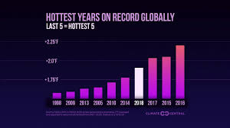
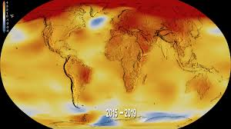
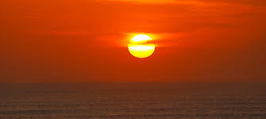
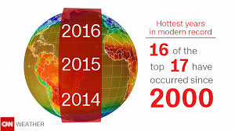
The 20 warmest years on record have been in the past 22 years.
The World Meteorological Organization (WMO) has compounded the research released in the 2018 IPCC report, stating that 20 of the warmest years on record have occurred in the last 22 years.
2017, carbon emissions increased globally by 1.7%.
2018, increase, up 2.7% from the year before.

Slide 11
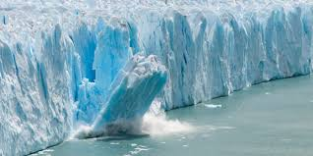
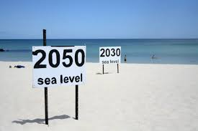
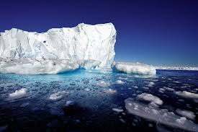
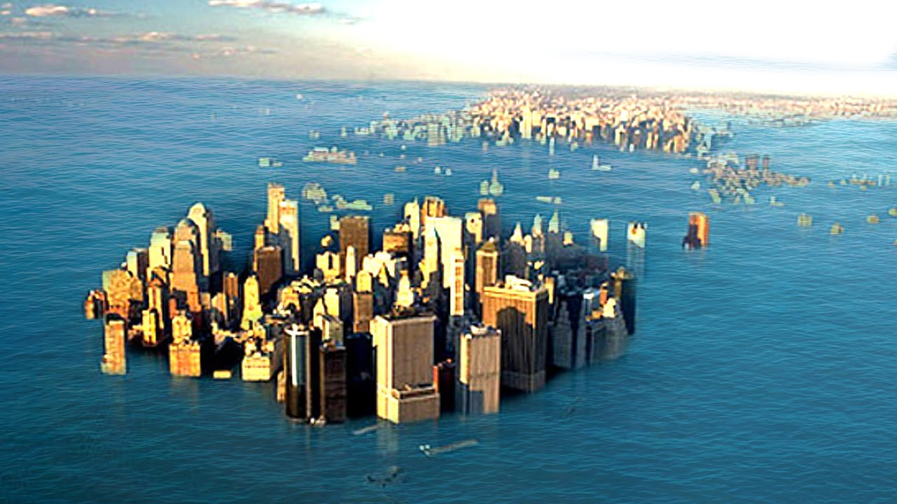
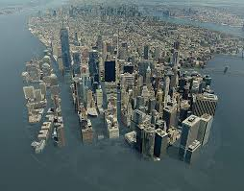
Rising sea
thermal expansion caused by warming of the ocean (since water expands as it warms).
melting of land-based ice, such as glaciers and ice sheets.

Slide 12
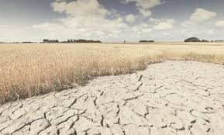
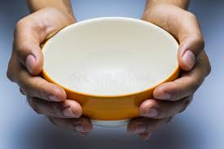
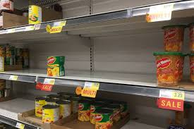
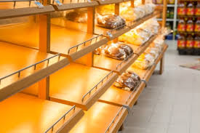
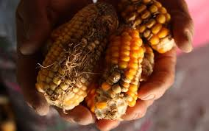
Food shortages
half a billion people already live in places turning into desert, and soil is being lost between 10 and 100 times faster than it is forming.
climate change will make those threats even worse, as floods, drought, storms and other types of extreme weather threaten to disrupt, and over time shrink, the global food supply.

Slide 13
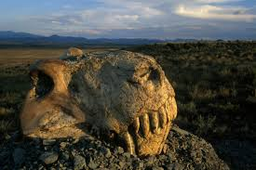
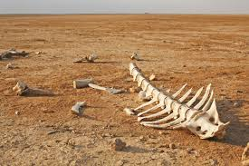
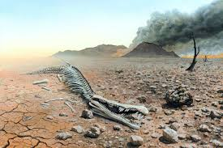
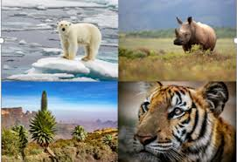
Possibly even mass extinctions
more than 1 million species are at risk of extinction by climate change.
Some scientists estimate as much as 30 – 50% of species on Earth would have disappeared by mid centaury.

Slide 14
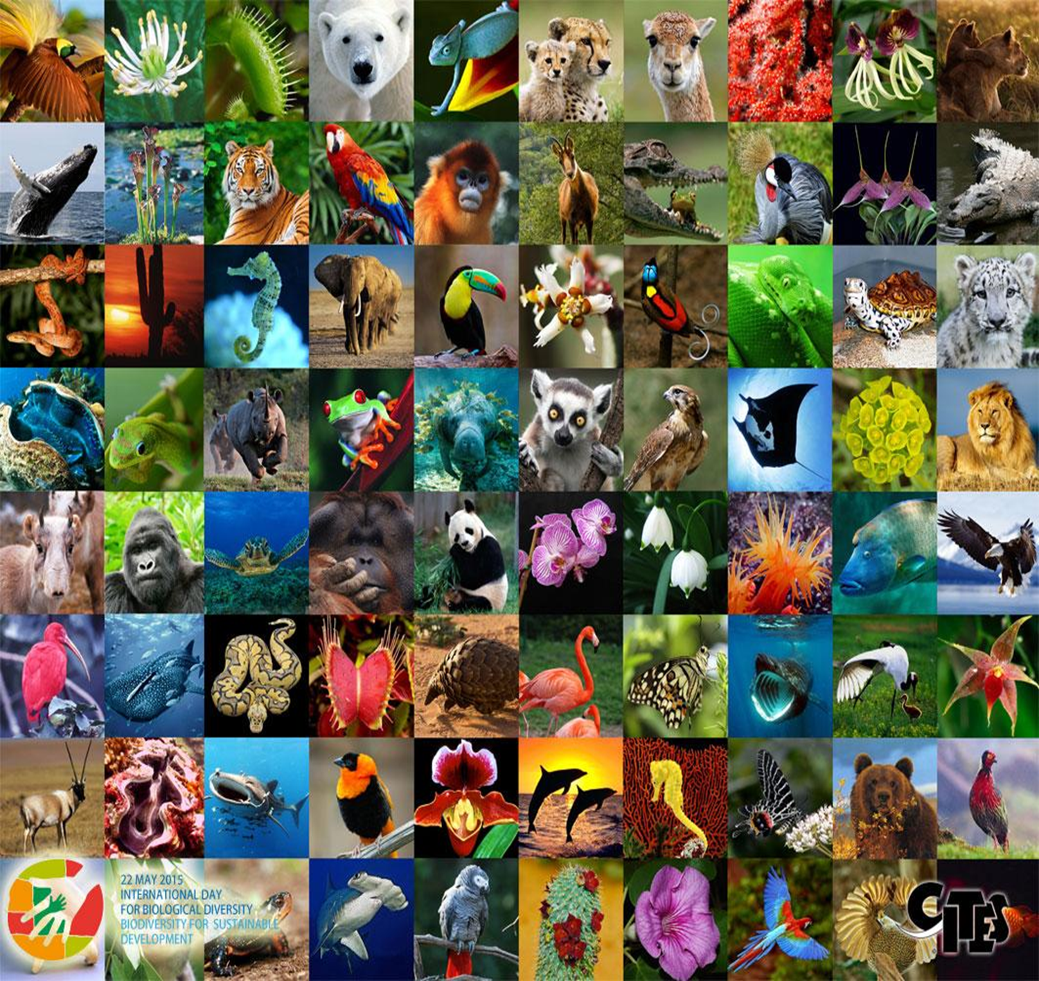
Allowing the extinction of so many species is “a crime equivalent to tossing books from the Library of Alexandria thoughtlessly into a fire, erasing the shared inheritance of all mankind,” according to the National Institute of Environmental Health Science in a review from 2009.
Vermicomposting:

Slide 15
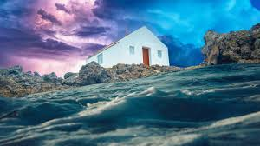
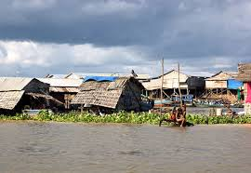
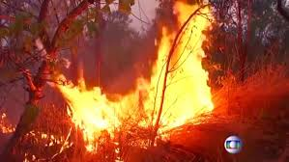
What most people don’t think about
What will happen when food production drops due to drought, floods, and extreme heat, which will cause food prices to soar and many foods to be scarce?
How storms will continue to grow more violent, costly, and catastrophic.
Damage to homes, businesses, and infrastructure will increase, as well as occur in more and larger areas.
How our normal lives will gradually grind to a near halt.

Slide 16

Putting it all together

Slide 17
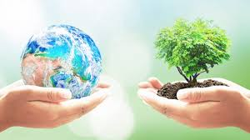

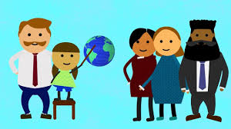
Everyone can make a contribution to climate protection!
"Avoid, reduce and compensate"
We can take responsibility for our own ecological footprints, i.e. for our CO₂ emissions.
Vermicomposting:
Follow these easy steps

Slide 18
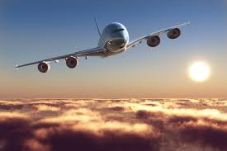

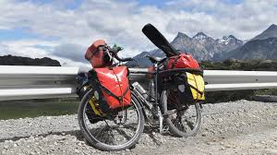

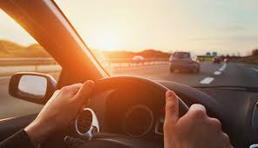
The most common everyday causes of harmful emissions are travel with cars or airplanes, heating and electricity usage and our consumption behavior.
Follow these easy steps

Slide 19
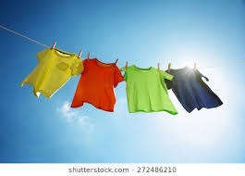
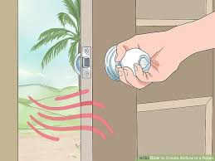
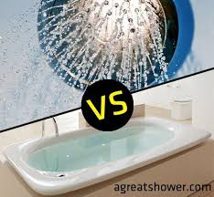
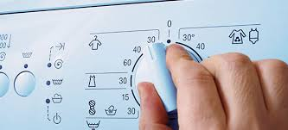
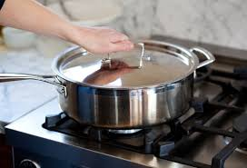
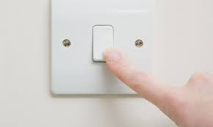

Some tips for saving energy
What else?

Slide 20

Vermicomposting:
What are you going to do differently?
https://www.youtube.com/watch?v=3sqdyEpklFU&feature=youtu.be

Slide 21
