Slide 1
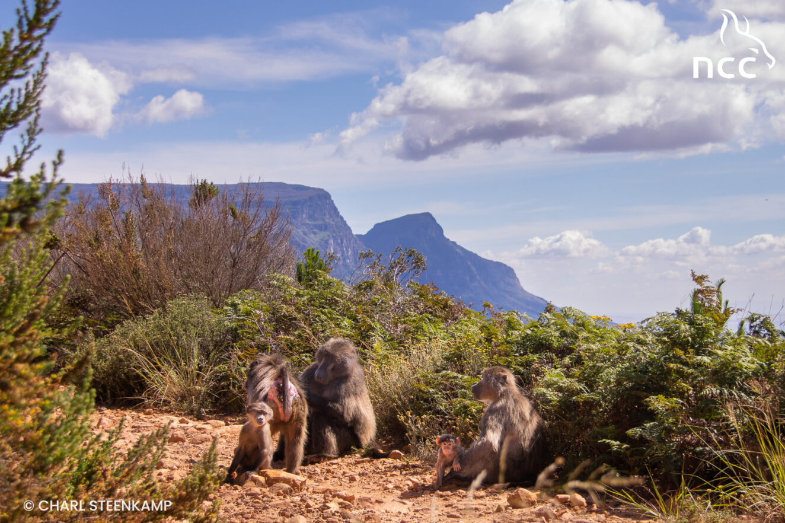

Slide 2
BABOON STRATEGIC MANAGEMENT PLAN Implementation, transitioning preparations, timeframes, way forward
CPBMJTT: SANParks, CapeNature, City of Cape Town

Slide 3
AGENDA
Time | Item | Speaker
16:30 | Welcome and introductions, purpose of engagement | Johan Taljaard, Chairperson of the CPBMTT
16:40 | CPBMJTT presentation | CPBMJTT members
18:00 | Way forward | Johan Taljaard
18:10 | How to prepare for upcoming engagements – what we know, what still needs to be determined | Rob McGaffin
18:30 | Closing remarks | Natalie Hayward Johan Taljaard

Slide 4
BACKGROUND – governance, outcomes, current context, interventions

Slide 5
BACKGROUND – June 2022 to date
The CPBMJTT published the approved Cape Peninsula Baboon Strategic Management Plan on 21 December 2023
Work on the draft plan commenced in June 2022, after Kirstenbosch roundtable discussions on baboon management within the Cape Peninsula
A draft plan was presented to the public for comment in January 2023; a stakeholder engagement meeting was hosted in Tokai in March 2023; and in the end, the JTT received and considered 800 individual comments emanating from the public participation period
In July 2023 the three spheres of government signed the Memorandum of Agreement that sets the foundation for the cooperation between the three parties for a more sustainable management plan for the Cape Peninsula’s Chacma baboon population.
July – December 2023 – assessed public comments and finalised the BSMP, conducted a fencing investigation
January 2024 – to date – preparations, institutional and otherwise, for engagements with public, affected communities, and stakeholders

Slide 6
BACKGROUND – June 2022 to date
We are now embarking on engagements with affected communities, stakeholders, and NGOs
The BSMP must be operationalised with specific local strategies that address the different needs, circumstances and geographical concerns of impacted communities, to ensure these are best suited and most appropriate to their respective areas.
Baboon Advisory Group (BAG)
Recognised community organisations such as ratepayers associations from baboon-affected areas, stakeholders, advocacy groups and research institutions will be invited to nominate a mandated representative to serve on the Baboon Advisory Group (BAG).The BAG will work with the CPBMJTT on achieving the intended outcomes of the BSMP and support its implementation, while ensuring feedback and communication between constituencies and the CPBMJTT.
Importantly, the BAG will serve as an advisory body, not a decision making body

Slide 7
GOVERNANCE structure
CPBMJTT – members have been nominated by their respective authorities to serve on the JTT. These are officials delegated by their authorities to oversee the implementation of the transitioning period and effective implementation of the BSMP in cooperation with communities and stakeholders
The JTT members do not act as individuals, but represent the authorities
The JTT is responsible for the implementation of the BSMP in accordance with the respective mandates, roles and responsibilities of the represented authorities
Joint Baboon Operations Team – the JBOT consists of officials (technical experts) from the three authorities
The JBOT deliberates on operational matters as it relates to interventions required to manage dispersing males and splinter troops
The JBOT recommends interventions to the JTT, in line with the baboon management guidelines as adopted by the JTT
The JTT discusses the recommended interventions; and may support or not support the recommendations for execution by the JBOT

Slide 8
BSMP Outcomes (1 of 2)
Vision
A sustainable and wild baboon population living in natural landscapes on the Cape Peninsula where people live in harmony alongside nature.
Note: ‘natural landscapes’ refers to any natural area, including the TMNP, Navy land, any other natural area, also noting that these could have different ownership and this will mean different mandates and responsibilities in accordance with the owner of the land
Purpose
“The sustainable management of the baboon population of the Cape Peninsula”

Slide 9
BSMP Outcomes (2 of 2)
The seven outcomes in a nutshell
A wild baboon population is sustainably managed and conserved
Provision for regulatory requirements and promotion of compliance and law enforcement
Informed solutions and local action keep baboons in natural landscapes and reduce human – baboon conflict
Effective waste management ensures baboons cannot access human derived food
Communication, education and awareness enable conservation and wellbeing of baboons and mitigation of human-baboon conflict
Baboon friendly infrastructure and services
Adaptive management by monitoring, evaluation, research and stakeholder feedback

Slide 10
OPERATIONALISING the BSMP
Item | Comment | Included in BSMP
Strategic Fencing | Critical part to solutions going forward, all three authorities involved | Yes, reduce human/baboon conflict
Waste Management Animal-proof bins | Residents, business, SA Navy, City, SANParks, CapeNature | Yes, effective waste management
Population Control | Contraception / removal | Yes, adaptive management
Translocation/removal of troops /dispersing and raiding baboons (predominately male baboons) / euthanasia | Part of interim guidelines as adopted by CPBMJTT | Yes, adaptive management
Rangers/monitors | Current service provider’s contract ends on 31 December 2024. The three authorities do not have funds available to continue this service, as such alternative funding sources must be explored by those communities who opt for rangers/monitors as from 1 January 2025 | Yes, baboons are sustainably managed and conserved
Electricity, warning signage, development management | City primarily responsible – MPBL to consider human/wildlife interface | Yes, baboon friendly infrastructure and services
Ethics | Ethics is standard practice for any research intervention; ethics and animal wellbeing are included in standard decision making | Adaptive management
Education and awareness | Shared responsibility between CPBMJTT, stakeholders, BAG, affected communities | Yes, communication, education and awareness

Slide 11
CONTEXT – Cape Peninsula Baboon Population (1 of 2)
The Baboon population north of Plateau Road has increased by 88% from 245 individuals in 2006 to 461 in 2024
Thus, the population of all troops on the Cape Peninsula (including Plateau Road and Cape Point troops) currently consists of nearly 600 (about 590) individuals
Excluding CT2 (20 baboons) which are north of Constantia Nek; there are about 570 baboons south of Constantia Nek
A previous estimate of ecological and management capacity of the baboons South of Constantia Nek was between 450 to 566 (Gaynor 2000, Hoffman & O’Riain 2012)
Adaptive management interventions in the interest of the wellbeing of the greater Cape Peninsula Chacma baboon population must be implemented
Some of these interventions may not be popular with or supported by all residents and interest groups

Slide 12
CONTEXT – Cape Peninsula Baboon Population (2 of 2)
Number of dispersing male baboons is concerning – notably in Tokai, Sunnydale and Capri, Kommetjie
We have seen the formation of splinter troops such as CT2 in Constantia and the Seaforth troop in Simon’s Town
We have seen considerable population growth
Baboon rangers are less effective in the absence of interventions (wildlife management tools) such euthanasia, relocation, translocation, and because baboons get used to paintball-markers, noise, etc.
No single one solution is the answer, be it rangers or fences, but a combination of all possible tools including waste management and resident education, must be implemented/used as needed, and where appropriate, to ensure sustainable management and to keep baboons out of the urban areas and in the natural environment

Slide 13
INTERVENTIONS and decisions (1 of 3)
The JTT adopted the interim guidelines to guide decisions and interventions concerning individual baboons – dispersing male baboons and raiding baboons in particular; habituated troops; splinter troop formation, etc.
The JTT has over the last 6 months acted to move various baboons, including one baboon that dispersed to Hout Bay
Various other dispersing males in Tokai, Capri/Sunnydale, Kommetjie/Fish Hoek, and Scarborough are currently being investigated
Raiding males in Urban Areas (JTTG03) are being investigated for case history submission to the JBOT for discussion and recommendation to the JTT for final decision and implementation
Situational report of the Navy properties has been prepared for discussion and action

Slide 14
INTERVENTIONS and decisions (2 of 3)
Seaforth troop
The JTT decided last year that the troop should be captured and relocated to a natural area on the Cape Peninsula as soon as the situation allows. The troop posed a risk to the critically endangered African Penguin colony, and the risk of human/animal conflict is high as the troop frequents popular beach areas and surrounds. The troop was to be returned to a natural area on the Cape Peninsula as they originated from, and are still located within this area.
The troop currently roosts in the natural area but still raids. However, the troop will only be moved if it returns and spends the majority of its time in the urban area and threatens the African Penguin and beach goers.
It is impossible to give an exact date or timeframe. Baboons are unpredictable and wild animals. Also, these operations are logistically complicated
The support and cooperation of the local community is vital to ensure the successful capture and relocation of the troop, for example, interference with the capturing will complicate and delay this operation.
The JTT will liaise with the Cape of Good Hope SPCA, and will keep the Simon’s Town community informed.

Slide 15
INTERVENTIONS and decisions (3 of 3)
CT 2
The CPBMJTT is currently investigating the possibility of relocating the whole troop to a natural area outside of the Cape Peninsula.
Feasibility studies are underway, among which an analysis of the risks involved with such an operation, including the risk of disease to the receiving environment, costs, and available budget.
The relocation of CT2 is based on the fact that the splinter troop has moved beyond Constantia Nek, thus, to the areas north of the Nek.
It is nearly impossible to manage a troop once they have moved into this area as the private properties are large, have big trees which baboons use to move between properties and utilise to avoid rangers/monitors who are moving on foot.
Given the limited carrying capacity of the natural environment, there is no space for this troop of about 20 individuals on the Cape Peninsula.

Slide 16
FENCING

Slide 17
Baboon Strategic Fencing – Simon’s Town example
Community Involvement
Liaison with communities as to location and erection of fences
Fence Monitors
Fence and open ends will have to be monitored for the fence to be effective
The Urban Baboon Programme (NCC contract) ends on 31 December 2024
Thus, monitors will have to be funded by communities
Once fence is installed, only then will it be certain how many monitors are needed
Constraints
Terrain
Some communities may oppose fences
Environmental authorisations
Procurement
Administrative process (MoAs)
Costs:
The City has a tender in place that can be used to erect fences
The City and SANParks have some budget available
SANParks will maintain fences on their land
In some areas of private land – communities will need to maintain fence
Areas, where the fences will be easy to install and environmental approvals are not needed, have been prioritised
We can commence with the installation as soon as the communities agree
Progress
Initial fences will focus on SANParks land located in Scarborough, Simon’s Town and Constantia
SANparks and the City have walked fence lines, and busy drawing up MoAs

Slide 18
WASTE MANAGEMENT

Slide 19
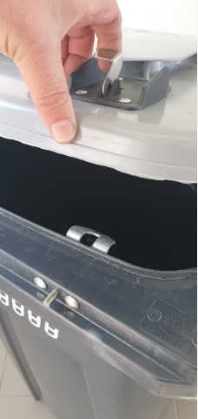
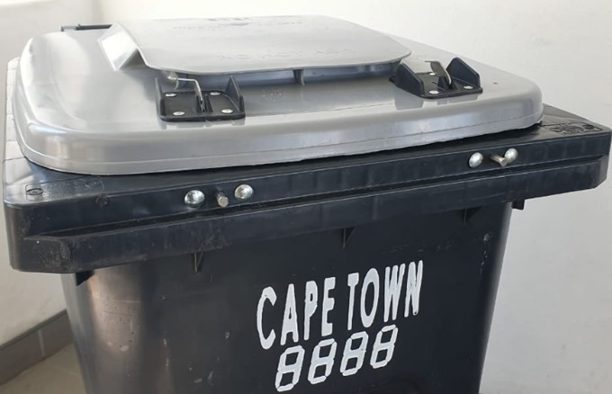
LOCKABLE BINS
Wildlife Locking Device
The double lock works better than the gravity lock
New 3-year contract, 2000 locks will be fitted with effect
from 30 April 2024
Locks will be fitted to existing wheelie bins
First roll-out will be in Simon’s Town, once locks are fitted
Will take a number of years to complete roll-out,
Kommetjie, Scarborough, Glencairn, DaGama Park, Capri, Sunnydale to follow after Simon’s Town
Lack of City funding will limit roll-out.
The double lock is costly in relation to the bin itself.

Slide 20
THE WAY FORWARD

Slide 21
Next steps (1 of 2)
This meeting is being recorded, and the recording and presentation will be available on the three authorities’ websites later this week
We are taking note of attendees’ questions and will use this in preparing for our individual meetings with affected communities, stakeholders, NGOs, etc.
Meetings with affected communities – to be concluded by May/June 2024, JTT will circulate a programme of meetings, dates and times; will be hosted online as it will be easier and more convenient to arrange and attend, can accommodate unlimited number of people as opposed to a physical venue
At these meetings communities and the JTT will collaborate on proposed solutions specific to the area (what the authorities can do/fund; what we cannot do/fund, for example)
How to prepare: It is advisable that communities meet and discuss their current needs, concerns, and possible solutions in advance, before they meet with the JTT
Communities are also advised to discuss whom they would nominate to present them on the BAG – two representatives are recommended
The BAG, once established, will advise the JTT on communities’ specific needs and concerns
The BAG will inform their respective communities of the JTT’s decisions, interventions, and distribute any relevant information as/when needed

Slide 22
Next steps (2 of 2)
Meetings with stakeholders, NGOs, interested and affected parties – concluded by May/June 2024
Call for nominations for the BAG – mid-April 2024
BAG to be constituted by 1 June 2024 with inaugural meeting
Devising area-based solutions in cooperation with affected communities – ongoing
Formalising affected communities’ response to baboon challenge – to be concluded by 30 October 2024
Guidance to communities in terms of how to fund possible solutions beyond those that will not be funded by the three authorities, amongst which baboon rangers/monitors – ongoing

Slide 23
What we know (1 of 2)
The sustainable management of baboons is a shared responsibility between the three authorities and communities
There is a lot we can implement now, and the sooner we agree on these, the sooner we can get going
Budget is available to start installing fences in areas where no environmental approvals are needed
SANParks will install and maintain the fences on their land
The City has funding to install fences in some areas
Fences need to be monitored to ensure efficiency
Lockable bins will be available to Simon’s Town community by 30 April 2024
We need to bring the baboon population in line with the natural area’s carrying capacity
CT2 will be relocated to an area outside of the Cape Peninsula
Seaforth will be relocated to a natural area within the Cape Peninsula

Slide 24
What we know (2 of 2)
The JTT has tools available to act/intervene in terms of the guidelines
These guidelines have been developed over years, in collaboration with scientists and experts in the field
All areas frequented by raiding males and dispersing males – case histories are used to recommend interventions in terms of the guidelines and these will be implemented with immediate effect, once the JTT has made a decision
The Urban Baboon Programme (NCC’s contract) ends on 31 December 2024, thus, thereafter the authorities will no longer fund baboon rangers

Slide 25
What still needs to be determined (1 of 2)
Mechanisms for communities to organise themselves to engage with the JTT on site level solutions and interventions
Financing services/interventions such as baboon ranger/monitoring services as from 1 January 2025
Wildlife levy, Special Ratings Area, Central Improvement District, include it in rates bills?
Funding models will take time to establish, and we will have to collaborate on solutions
Compilation of case histories on raiding males, dispersing males, and splinter troops once NCC’s contract ends on 31 December 2024.
Monitoring baboon troops’ movements in general, as from 1 January 2025

Slide 26
What still needs to be determined (2 of 2)
How many rangers/monitors will be needed to monitor a fence – the design of the fences, where they will be installed, will determine this
How many rangers/monitors will be needed to monitor areas with no fences
The cost of one ranger/one monitor per month
We acknowledge that communities who many not have fences installed by 1 January 2025 may be concerned about the withdrawal of rangers by 31 December 2024

Slide 27
THANK YOU

